Slide 1
Cannabis & Public Health in Rhode Island
New Initiatives Training: The Courts, Schools, and Child Welfare Conference, Sept 9, 2024
Madison K. Rivard, MPH

Slide 2
It is important to recognize the history of racial and ethnic discrimination in which the term “marijuana” has been used, popularized, and connected to the War on Drugs.
This presentation uses the terms “cannabis” and “marijuana” to most accurately and clearly communicate the data.
The term cannabis is more scientifically accurate and racially and ethnically sensitive. It will be used throughout the presentation to refer to Rhode Island’s legislation legalizing adult use (i.e., The Rhode Island Cannabis Act) as well as in reference to other related topics.
The term marijuana will be used to reference the State’s program for medical use (i.e., Rhode Island Medical Marijuana Program). It will also be used when reporting from research studies, as well as standardized State and national surveys.
Using the Terms Cannabis versus Marijuana

Slide 3
Historical Context of Cannabis in the U.S.
Pre-1900s: Cannabis was used medicinally and prescribed by physicians
1930s: Term ‘marijuana’ was introduced to negatively associate the plant with Mexican immigrants and utilize fear and racism
Campaigns inaccurately link cannabis to criminal or deviant behaviors
1930-50s: Cannabis restrictions began (Two- to 10-year prison sentence and $20,000 fine)
1970: Marijuana declared a Schedule I substance
1986: Racially biased penalties enacted for marijuana and crack cocaine
1990s: War on Drugs criminalizes cannabis and other drugs instead of reducing risk or harms
Rhode Island
2006: Medical Marijuana Program (MMP) began, regulated by RIDOH
2013: Cannabis decriminalized, possession becomes civil offense (fine, no jail time/criminal record)
2022: Adult Use legalized, sales began in December and regulated by DBR/CCC

Slide 4
How Cannabis Affects the Body:
Endocannabinoid System
Cannabis has health benefits for some people and health risks for others
Endocannabinoids and phytocannabinoids
Prior medical history and comorbid conditions
Dose and method of ingestion matters
The Rhode Island Medical Marijuana Program includes eligible debilitating medical conditions (e.g., chronic pain, PTSD, chemotherapy)
More research is being conducted on the health risks and benefits in certain populations

Slide 5
Cannabis Regulations in Rhode Island
1) Medical Cannabis
Medical Marijuana Program started in 2006 and is regulated by RIDOH
Need a medical card; sold at dispensaries (currently seven in Rhode Island, but more to come)
Requires qualifying medical condition (e.g., chronic pain, PTSD, cancer, HIV, seizures)
2) Cannabis for Adult Use
RI Cannabis Act legalized sales starting in December 2022
Regulated by the Cannabis Control Commission
Must be 21 or older and show identification; sold at dispensaries
3) Hemp
Cannabis that contains less than 0.3% Δ9-THC (all other cannabinoids e.g. CBD, Δ8-THC)
Federally legal from the 2018 Federal Farm Bill; regulated by RI Department of Business Regulation
Often used for textiles, fuel, paper, and other industrial uses
Sold for consumption in many unregulated places, most often as CBD

Slide 6
Cannabis for Medical Treatment
The Rhode Island Medical Marijuana Program at RIDOH started in 2006.
Approved qualifying medical conditions, include:
Cancer or cancer treatment, including chemotherapy or radiation
Glaucoma or glaucoma treatment
Positive status for HIV or treatment for HIV
AIDS or treatment for AIDS
Hepatitis C or treatment for hepatitis C
A chronic, debilitating disease or medical condition or its treatment that produces one or more of the following:
Cachexia or wasting syndrome
Severe, debilitating, chronic pain
Severe nausea
Seizures, including but not limited to those characteristic of epilepsy
Severe and persistent muscle spasms, including but not limited to those characteristic of multiple sclerosis or Crohn's disease
Agitation related to Alzheimer's Disease

Slide 7
Cannabis and Benefits
Cannabis and Risks
Studies have shown short-term effects can include:
Impaired memory
Poor motor coordination
Altered judgment
Psychotic symptoms
Effects from long-term use may include:
Exacerbation or earlier onset of mental health conditions for those already at risk
Dependence
Neurocognitive impairment
Cardiovascular or respiratory disease
Studies have shown that cannabis may help treat some people with:
Chemotherapy-induced nausea and vomiting
Chronic neuropathic pain
Inflammatory conditions
Parkinson’s disease symptoms
Epilepsy

Slide 8
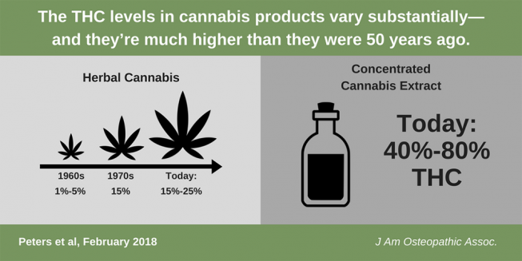
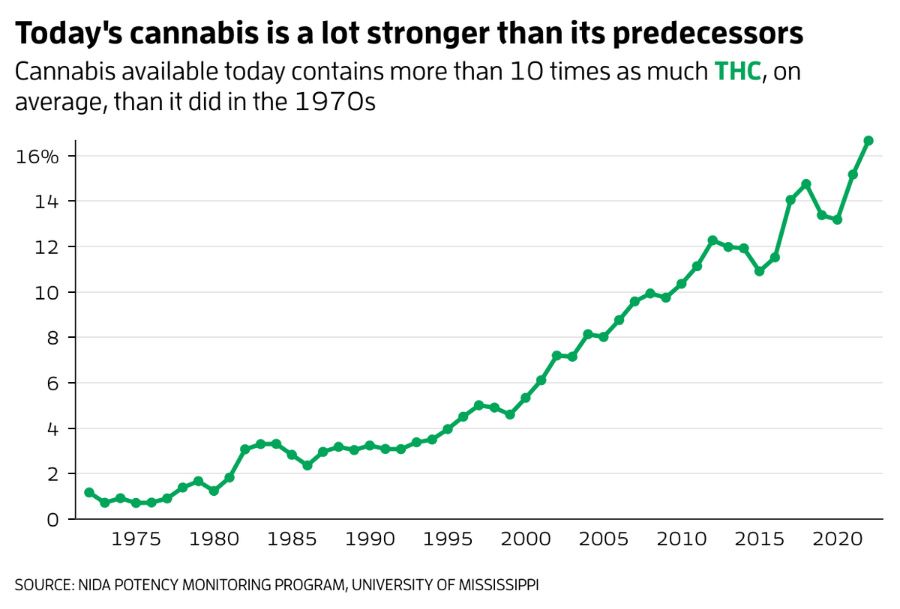
Cannabis Potency
The percentage of THC in a cannabis product is the amount of intoxicating substance that causes a high.
The greater the percentage, the higher the risk for negative health effects.
Notes:
Source: https://thedo.osteopathic.org/2018/02/know-prescribing-cannabis/
https://www.newscientist.com/article/2396976-is-cannabis-today-really-much-more-potent-than-50-years-ago/#:~:text=A%20study%20from%202020%20examined,year%20from%201970%20to%202017.

Slide 9
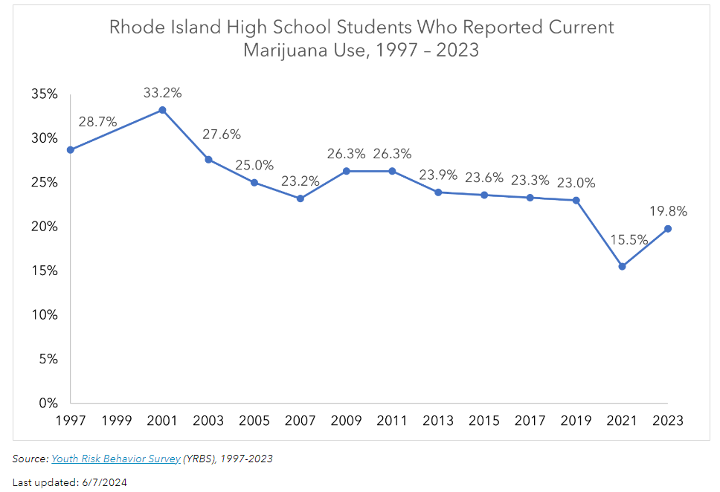
Cannabis Use by Rhode Island High School Students, 1997 - 2021
Rates of reported cannabis use by high school students have been decreasing since 2011.
YRBS Question:
During the past 30 days, did you use marijuana?
Data Source: YRBS

Slide 10
Cannabis Use Trends from 2022 to 2024 among RI Middle & High School Students
Significant INCREASES in
Perceived peer and parent disapproval of use of marijuana (smoke or vape) among high school students
Perception of risk or harm with use of marijuana (smoke or vape) among high school students
Past 30-day marijuana use (smoke or vape) among middle school students
Significant DECREASES in
Past 30-day use of marijuana (smoke or vape) among high school students
Ever use of marijuana (smoke or vape) among high school students
Ease of access of marijuana (smoke or vape) among high school students
Percent of high school students who have ever driven or been a passenger in a vehicle driven by someone under the influence of marijuana
Source: 2024 RI Student Survey

Slide 11
Cannabis and Rhode Island Adults older than 18 years, 2017 - 2022
BRFSS Question:
During the past 30 days, did you use marijuana?
Rates of reported cannabis use by adults older than age 18 have been increasing in recent years.
Data Source: BRFSS

Slide 12
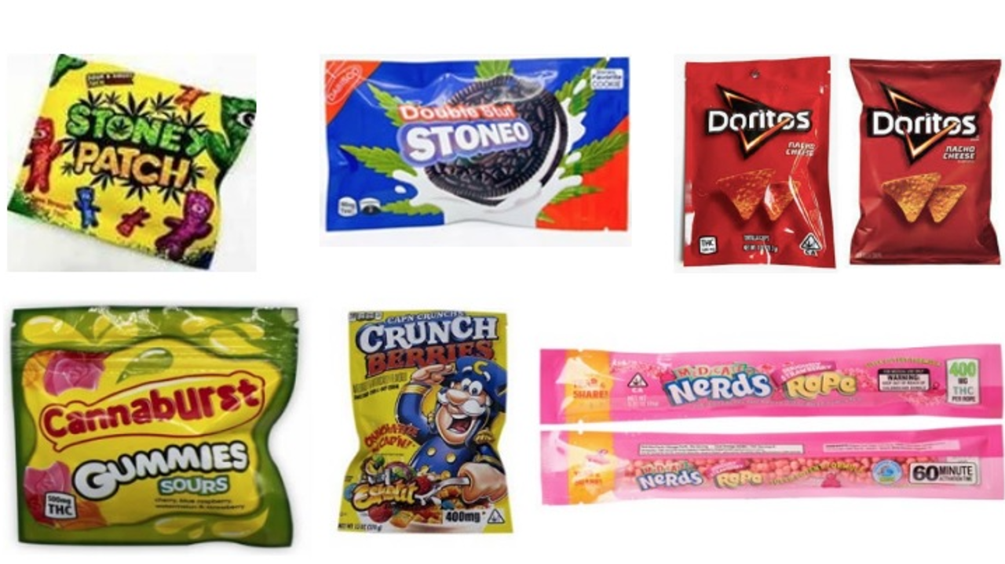
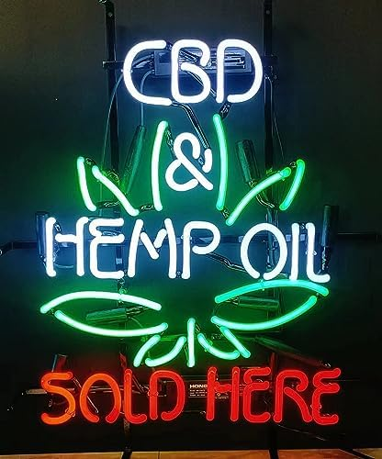
Examples of Unregulated Cannabis Products

Slide 13
Harm Reduction Recommendations
Avoid using cannabis with other substances (e.g., alcohol, tobacco, other illicit drugs)
Do not use cannabis before or while you are driving a car
T-breaks or tolerance breaks can have significant health benefits
Those who have mental health concerns or are predisposed to mental illness should seek advice from their doctor before using cannabis
Seek mental health support and resources to treat depression or anxiety
Avoid cannabis products if you don’t know where they came from or if you suspect they’re not from a legal source
Avoid high-concentration THC products; seek out a balanced ratio of CBD : THC
Wait to use cannabis until age 21 or older
Keep cannabis products stored securely and away from where children or pets could access
13

Slide 14
Thank you! Questions? Comments?
Madison K. Rivard, MPH
Public Health Epidemiologist, Cannabis Use
Substance Use Epidemiology Program
Rhode Island Department of Health
madison.rivard@health.ri.gov

